Slide 1
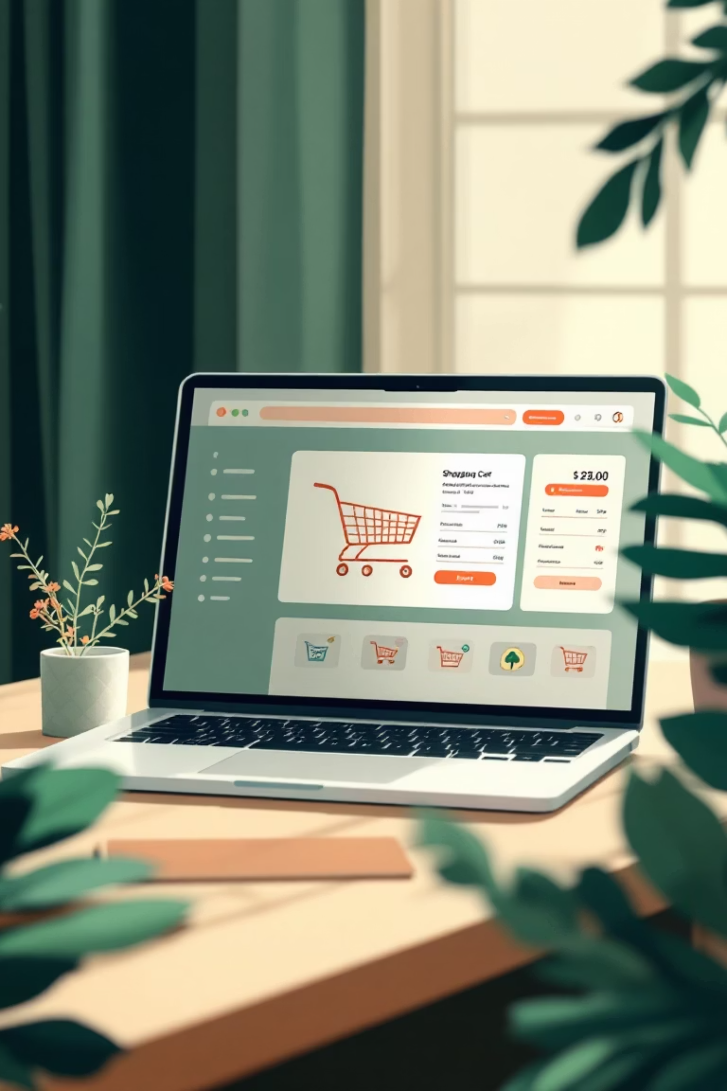
Shopping Cart Project
A full-stack e-commerce web application with secure authentication and dynamic cart management
Arya Rohan Rachamalla • Reg: 3122256002002.

Slide 2






Project Overview
MVC Architecture
Backend Stack
Clean separation using Model-View-Controller pattern for maintainability and scalability
Node.js + Express.js with MongoDB and bcrypt for secure password hashing
Frontend Design
Core Features
Responsive UI built with HTML, CSS, Bootstrap, and JavaScript
User accounts, product browsing, cart management, and payment simulation

Slide 3

Technical Requirements
Development Tools
Dependencies
Additional Needs
Express.js framework
Visual Studio Code
Modern web browser
Mongoose ODM
Node.js runtime
bcrypt library
npm package manager
MongoDB Community Server
Bootstrap CSS
Mongo Shell (mongosh)

Slide 4
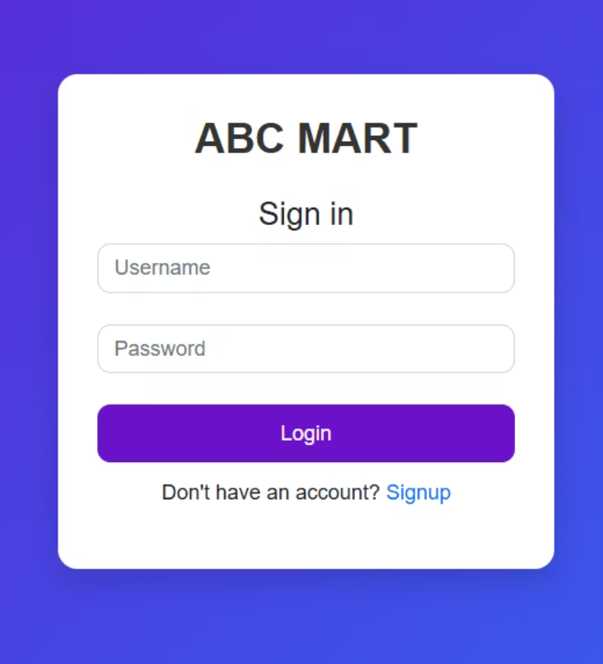
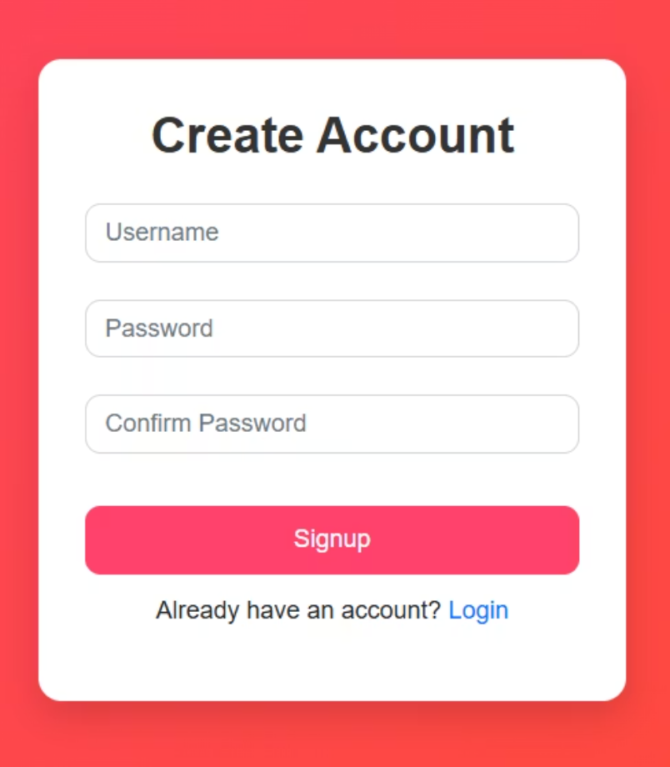
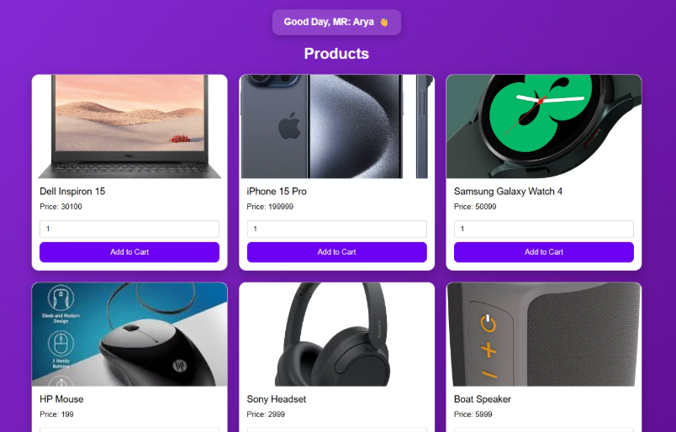
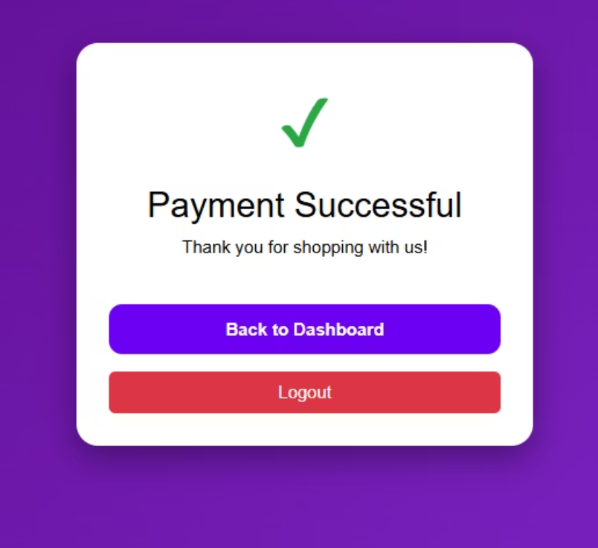
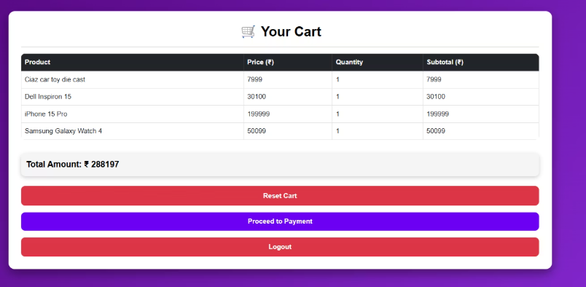
User Interface Screens
Login Page
Signup Page
Dashboard
Cart & Payment
Personalized welcome with product catalog
Secure authentication with validation
Password strength check and username availability
Dynamic cart with payment simulation

Slide 5
Core Functionalities
01
02
03
User Signup
Secure Login
Browse Products
Password validation (8+ chars, special char, number, uppercase) with bcrypt hashing stored in MongoDB
bcrypt compares credentials; successful match loads personalized dashboard
Dashboard displays items with personalized greeting and add-to-cart functionality
04
05
Cart Management
Checkout Flow
MongoDB updates user's cart; dynamic total calculation and item count
Payment button activates when cart has items; dummy payment interface completes flow

Slide 6
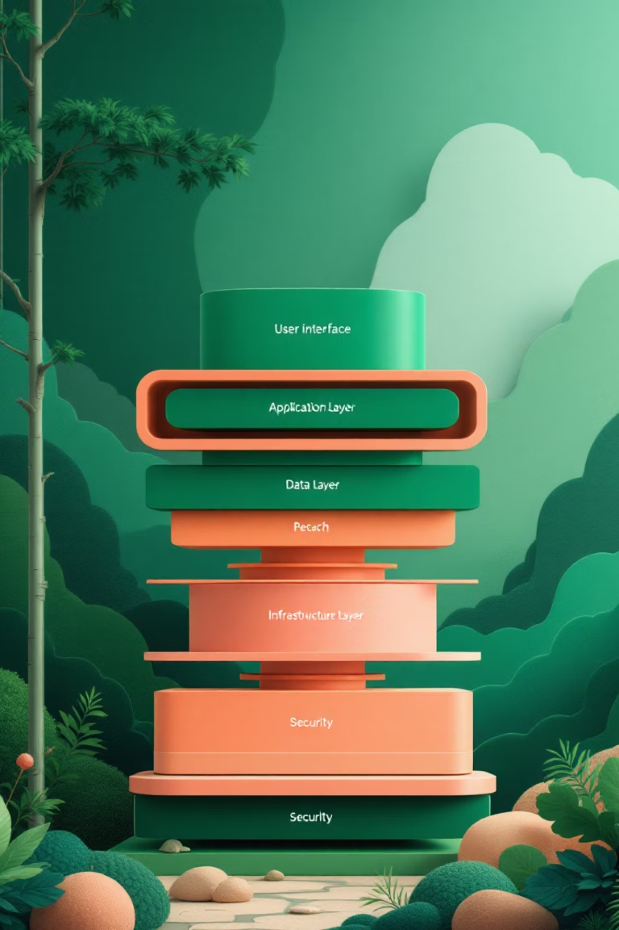
Technical Architecture

Slide 7
Technology Stack
Frontend Layer
Backend Layer
HTML, CSS, Bootstrap for responsive design with JavaScript for dynamic interactions
Node.js with Express.js framework handling routes and business logic
Database Layer
Security Layer
MongoDB (NoSQL) with Mongoose ODM for schema management
bcrypt hashing library for password encryption and authentication

Slide 8




MVC Architecture Flow
View Layer
HTML pages styled with Bootstrap and JavaScript
Controller Layer
Express routes handle /login, /signup, /dashboard, /add-to-cart
Model Layer
Mongoose schemas for User with username, password, items, billing
Client requests flow through Express routes, interact with Mongoose models, retrieve/save data, and return rendered views

Slide 9

Design Patterns
MVC Pattern
Separates Model, View, Controller for maintainability and simplified debugging
Observer Pattern
DOM events trigger UI updates based on cart changes
Singleton Pattern
Mongoose maintains single reusable database connection
Factory Pattern
Schemas create standardized user and item objects
These patterns enhance modularity, maintainability, and scalability across the application

Slide 10


Database Verification
MongoDB Shell Access
Stored User Data
Using mongosh commands to verify data:
Each user document contains:
Username (e.g., Arya, Rohan)
show dbs - list databases
Hashed password
use shoppingCart - select database
Cart items with quantities
show collections - view collections
Billing amount calculation
find().pretty() - query user data
Independent carts per user
Server Status: Running on port 5000
GitHub Repository: github.com/Aryacoding1131/ShoppingCart_Project.git

